Slide 1


Supporting your application:
Choosing your options

Slide 2

In pairs or small groups, put the following statements onto the continuum. Discuss/debate why you have chosen to put each statement where you have.
Factors you may consider when choosing your sixth form college subject options:
Enjoy the subject
Friends are taking it
Need it for future job/university
You want a variety of subjects
Coursework vs no coursework
Want to try something new
Good at it at GCSE
Like the teacher
Least important
Most important
Notes:
1)Launch the PDC – What does it mean to you? What is your vision for your year group? How does it link to Jen’s launch?
2) Discuss your intent with your year team and talk them through why it is important to you.
3)Give time for your tutor team to read your intent, highlight the parts that resonate with them and reflect on what they are going to focus on to ensure that their tutees are ‘well-rounded’ individuals. It would also be worthwhile to get your tutor teams to reflect on aspects of your intent that they may not have considered for a while.

Slide 3
Advice from Year 12 students:
Pick subjects that you will enjoy. You’re going to have to work on them a lot.
Don’t pick subjects because your friends are. You are going have to do well in it.
A Levels are hard. Make sure you have strong knowledge at GCSE level as most subject build upon this knowledge.
Don’t be scared of trying something new. There is the option to change subjects at the start of Year 12 if you don’t like it.
Read about the courses on the website. Speak to your teachers and older brothers/sisters/friends in Sixth Form.

Slide 4
If you have time, visit the course guide on the college website.
Here you will find information on all the courses we offer and videos from staff telling you about the course.
https://toothillcollege.co.uk/courses.php
The next slide has some FAQs regarding course choices that your tutees may have

Slide 5
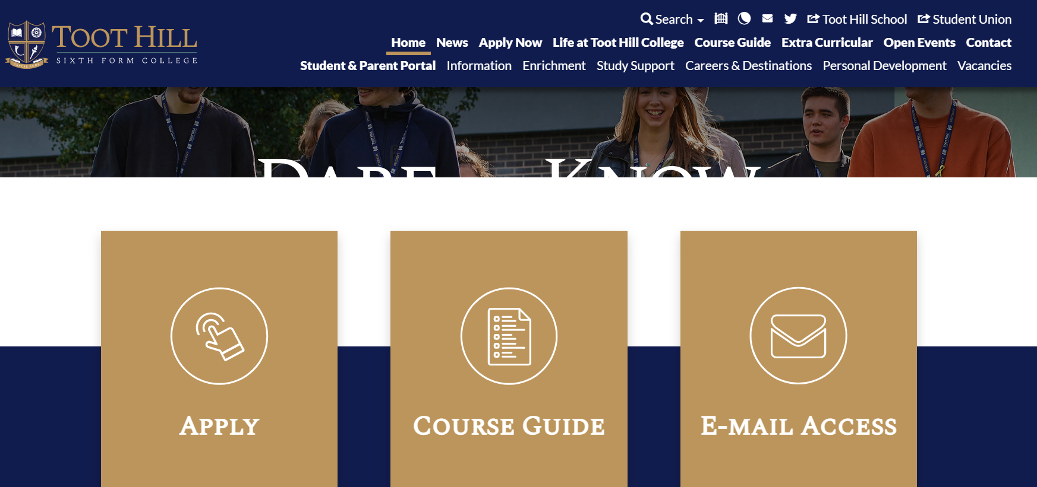
Information on all our courses and their entry requirements can be found here and here:

Slide 6
Q: How many subjects do I need to take?
A: All students must take the equivalent of 3 A Level courses. (Single BTEC awards count as one, Double BTEC awards count as two).
Q: Can I take more than 3 A Levels?
A: We consider students taking 4 A Levels on a case by case basis. Taking 4 is a lot of work, so we only usually allow this for students who achieve mostly grade 8/9 at GCSE. If you wish to take Further Maths A Level, we automatically allow this to be taken as a fourth A Level.
Q:Do universities accept vocational courses?
A: YES. All the courses we offer at Toot Hill are accepted by universities. When applying for universities, your grades are converted into points. BTEC courses are awarded grades of Distinction*, Distinction, Merit and Pass. These are equivalent to A Level grades of A*,A,C and E respectively.
Q: Can I take a mixture of A Levels and Vocational courses?
A: Yes you can.
Q: What grades do I need to take X?
A: All our entry requirements can be found on the course guide on the website. You need to click on each subject to view their entry requirements. https://toothillcollege.co.uk/courses.php
Q: Can I change my choices?
A: Yes. We do recommend that you choose your choices on your application carefully as this decides the timetabling for the whole of Year 12. Students are able to change courses right up until end of September in Year 12 (but do need to catch up on missed work independently, no extra lessons are put on for you!). We cannot guarantee all changes made after the interview will be possible though, as the change will depend on it fitting the timetable, there being space on the course and that you have met the entry requirements for the course.

