Slide 1






CRE8TIVE RESOURCES
Secondary
Monday, 11 May 2026
Financial Abuse In Relationships
LEARNING OUTCOMES
Knowledge, Skills
& Actions
To be able to identify different types of financial abuse
To describe the difference between financial abuse and economic abuse
To explain the impact of financial and economic abuse on victims
2 minutes
True or false?
Abuse can only happen to children – FALSE
Abuse always involves physical harm to someone – FALSE
Abuse can be complicated and difficult to escape – TRUE
NEW VOCABULARY
Abuse, financial abuse, economic abuse, coercion, control, romance scam
Click to reveal
Click to reveal
Click to reveal
Notes:
TEACHER NOTES & IDEAS
Remind students of the learning journey (What theme you are doing – Possibly recap what they can remember from last lesson)
ATTRIBUTION AND COPYRIGHT
–Icons and logos for Cre8tive Resources are created by Michael Gillman and are subject to copyright ©
- All graphics and images are sourced correctly through the following sites:
Premium licence at https://www.freepik.com/
www.Pixabay.com
https://www.pixelscrapper.com/help
- Factual information is not copyrighted.
- Where information has been taken from reliable 3rd party websites – it is done so for analytical purposes in small pieces of text and for educational purposes.
DISCLAIMER
- Always check the content of any lesson and videos linked before teaching to ensure suitability for your classroom and your school
Responsibility for checking material for suitability for students must be done by the classroom teacher. This includes ensuring everything is appropriate including the external video links that have been provided.
The PowerPoint material is fully editable and we encourage teachers to remove, change or edit anything they wish.
Video links are working at time of creation of this lesson. Please bear in mind YouTube content owners can withdraw their content at any time and responsibility lies with the classroom teacher to ensure the content is updated and new video links are found.
Cre8tive Resources does not charge or provide a subscription update service for this lesson the responsibility for updating lesson content lies with the classroom teacher.
Further Terms and Condition regarding Copyright and our terms of use can be found on our website here https://cre8tiveresources.com/terms-of-use/

Slide 2

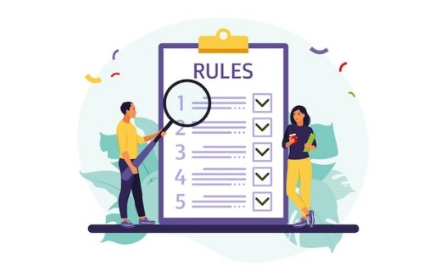


Be Respectful
Listen & don’t interrupt others
Only 1 person talking at a time
Use the agreed appropriate Language (Avoid slang terms)
Be open and honest
No Personal Comments Discussions must be about ‘general situations’
Don’t Make Assumptions about people’s values, attitudes, behaviours, life experiences or feelings
CLASSROOM RULES
DEALING WITH SENSITIVE TOPICS
SAFEGUARDING YOUR WELFARE & HAVING YOUR INTERESTS AT HEART
You don’t have to say things about yourself if you don’t want to
Be Non-Judgemental No put-downs. Challenge the opinion, not the person
It’s OK to be embarrassed by a topic but don’t show that you are embarrassed through silliness
Conversations on sensitive topics stay in the classroom unless it is a safeguarding issue
There are no stupid questions
It’s OK to get things wrong
Enjoy the lesson, challenge your perceptions and understand how to seek further advice and support
Notes:
TEACHER NOTES & IDEAS
Reinforce ground rules at the start of every new topic / new term
Adapt this set of rules to suit your classroom and your teaching.
Display your agreed PSHE classroom rules in a prominent place so students have a constant reminder and when/if a student breaks a rule you can use as a prompt to get them back on track.
If behaviour is an issue, revisit the ground rules – (Use raffle tickets, positive behavior management (look for the good behaviour)
Reward the behaviour you want to see, be consistent and fair with students.
Create a classroom charter with the students (optional)

Slide 3











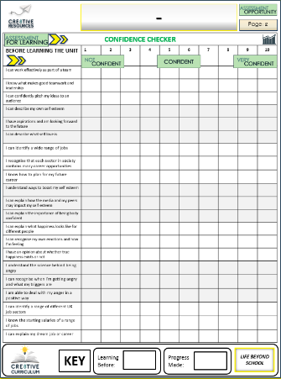


Recognising Emotional, Sexual and Physical Abuse
BASELINE CONFIDENCE CHECKER
BEFORE THE LESSON
Knowledge, Skills & Actions | 1 | 2 | 3 | 4 | 5 | 6 | 7 | 8 | 9 | 10
I can identify types of financial abuse in different scenarios
I can describe the difference between financial and economic abuse.
I can describe at least 5 impacts of financial and economic abuse on victims.
Complete a baseline assessment of where you think you are at for this lesson
(Discuss or complete sheet)
2 Minutes
I’m not confident at all on this topic
A little confident
Confident
Very
confident
I am super
confident on this topic
Notes:
TEACHER NOTES & IDEAS
This could be done by writing a number down in the books
Show of fingers in the air or red, amber & green cards
Quick partner discussion
Print off the Assessment Opportunity Sheet – Fill in the Baseline Confidence Checker

Slide 4
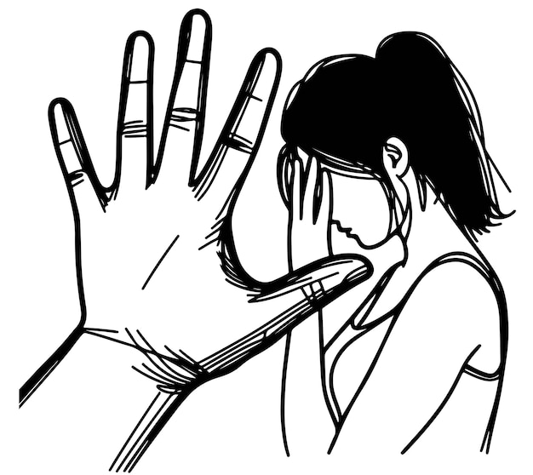
What is Financial Abuse?
Abuse is when someone repeatedly causes harm or distress to another person.
Financial abuse is where one person has control over another persons’ access to their money.
This limits the victim's capacity to support themselves and forces them to depend on the other person.
DID YOU KNOW?
Almost 2.5 million women in the UK have experienced a partner or ex-partner limit access to their bank account.
Task
In what ways could someone be financially abusive to a partner?
Notes:
Statistic - https://www.experianplc.com/newsroom/press-releases/2024/1-in-5-women-in-the-uk-have-experienced-economic-abuse--learn-ho?utm_source=chatgpt.com

Slide 5



Types of Financial Abuse
Control of income
Theft
Someone takes out loans or credit cards using your details without permission.
You are left responsible for repaying debts you never agreed to
Damages your credit score and financial future.
Someone steals your money, bank card, possessions, or financial information.
They might take your cash or make bank transfers / withdrawals from your account
This could be without consent or as part of a scam (lying)
Debt in your name
Someone takes charge of your earnings, benefits, or savings and decides how they are used
Restricts your access to your bank account (may give you a small allowance)
Results in financial independence on the other person
Notes:
https://refuge.org.uk/what-is-domestic-abuse/
Optional video -https://www.bbc.co.uk/teach/class-clips-video/articles/zvr7d6f

Slide 6
Spotting Financial Abuse
Control of income:
Mia has control of Jordan’s wages
Example:
Jordan works full-time, but his partner Mia insists all his wages go into her account. She only gives Jordan a small allowance for food and travel. At the same time, Jordan notices cash missing from his wallet whenever Mia borrows it, but when he asks her, she says he must have “miscounted.”
Theft:
Mia is taking cash from his wallet
Task
In groups, read the scenarios on your worksheet.
Highlight and annotate any examples of financial abuse you see.
Notes:
WORKSHEET

Slide 7
Spotting Financial Abuse
Holly shares a flat with her best friend, Ben. At first, she trusts him completely. But she starts noticing that cash goes missing from her purse after Ben has borrowed it to “grab some milk.” When Holly confronts him, he laughs it off, saying she’s “forgetful.” A few weeks later, Holly receives a bill for a store credit card she never applied for. The purchases are things Ben wanted—trainers, gaming equipment, and clothes. When she challenges him, Ben insists he’ll pay it back eventually, but months pass and the debt remains in Holly’s name.
Amir is a student who receives a small bursary and housing allowance. His girlfriend, Layla, demands that the money is paid into her account, saying she’ll “make sure it goes on rent and essentials.” She gives Amir only enough for basic meals. When Amir asks where the rest of his allowance goes, Layla tells him not to question her. Later, he receives a letter saying he owes money on a phone contract he never signed. Layla admits she took it out in his name, claiming it was “for both of them” and that Amir should be “grateful.”
Share your answers
Notes:
TEACHER NOTES: worksheet
Holly scenario – Theft + Debt in Your Name
Amir scenario - Control of Income + Debt in Your Name
Sophie scenario – all 3

Slide 8
Spotting Financial Abuse
Holly shares a flat with her best friend, Ben. At first, she trusts him completely. But she starts noticing that cash goes missing from her purse after Ben has borrowed it to “grab some milk.” When Holly confronts him, he laughs it off, saying she’s “forgetful.” A few weeks later, Holly receives a bill for a store credit card she never applied for. The purchases are things Ben wanted—trainers, gaming equipment, and clothes. When she challenges him, Ben insists he’ll pay it back eventually, but months pass and the debt remains in Holly’s name.
Theft:
Taking money from her purse and lying about it
Debt in name:
Applied for a credit card in her name and hasn’t paid it back
Notes:
WORKSHEET

Slide 9
Spotting Financial Abuse
Amir is a student who receives a small bursary and housing allowance. His girlfriend, Layla, demands that the money is paid into her account, saying she’ll “make sure it goes on rent and essentials.” She gives Amir only enough for basic meals. When Amir asks where the rest of his allowance goes, Layla tells him not to question her. Later, he receives a letter saying he owes money on a phone contract he never signed. Layla admits she took it out in his name, claiming it was “for both of them” and that Amir should be “grateful.”
Debt in name:
Applied for a phone contract in his name without consent
Control of income:
Holding Amir’s bursary and giving him an allowance
Notes:
WORKSHEET

Slide 10

Early Signs of Financial Abuse
Someone handling all financial matters
Monitoring and criticism of spending
Unexplained withdrawals or transfers of money
Discouraging working or studying
Discuss
What might some early signs of financial abuse be?

Slide 11

The Cycle of Abuse
Tension builds
Abuse
(lashes out)
Reconciliation
(apologies)
Temporary Calm
The cycle of abuse usually goes through 4 stages. The ‘calm after the storm’ makes it confusing for victims and difficult to leave abusive situations.

Slide 12
The Cycle of Abuse
Build-up of gaining control
Abuse (financial exploitation)
Justification or Excuses
Temporary calm and false promises
The cycle of financial abuse works very similarly to the cycle of domestic abuse, but focusses on economic control

Slide 13
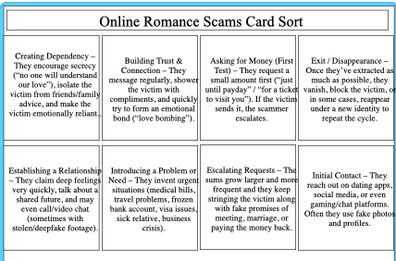


Online Romance Scams
Financial abuse can also happen in calculated online relationships known as
romance scams.
Task
Watch the video then put the steps in order of how a romance scammer may operate
Notes:
Most important part of video is 0.00 – 3.00
https://www.youtube.com/watch?v=amfXsZKQAxM
https://openclipart.org/detail/351472/broken-heart
Answers - Initial Contact – They reach out on dating apps, social media, or even gaming/chat platforms. Often they use fake photos and profiles.
Building Trust & Connection – They message regularly, shower the victim with compliments, and quickly try to form an emotional bond (“love bombing”).
Establishing a Relationship – They claim deep feelings very quickly, talk about a shared future, and may even call/video chat (sometimes with stolen/deepfake footage).
Creating Dependency – They encourage secrecy (“no one will understand our love”), isolate the victim from friends/family advice, and make the victim emotionally reliant.
Introducing a Problem or Need – They invent urgent situations (medical bills, travel problems, frozen bank account, visa issues, sick relative, business crisis).
Asking for Money (First Test) – They request a small amount first (“just until payday” / “for a ticket to visit you”). If the victim sends it, the scammer escalates.
Escalating Requests – The sums grow larger and more frequent and they keep stringing the victim along with fake promises of meeting, marriage, or paying the money back.
Exit / Disappearance – Once they’ve extracted as much as possible, they vanish, block the victim, or in some cases, reappear under a new identity to repeat the cycle.

Slide 14

Online Romance Scams
Financial abuse can also happen in calculated online relationships known as
romance scams.
Initial Contact
Building Trust & Connection
Establishing a Relationship
Creating Dependency
Introducing a Problem or Need
Asking for Money (First Test)
Escalating Requests
Maintaining Hope
Exit / Disappearance
Notes:
https://openclipart.org/detail/351472/broken-heart

Slide 15
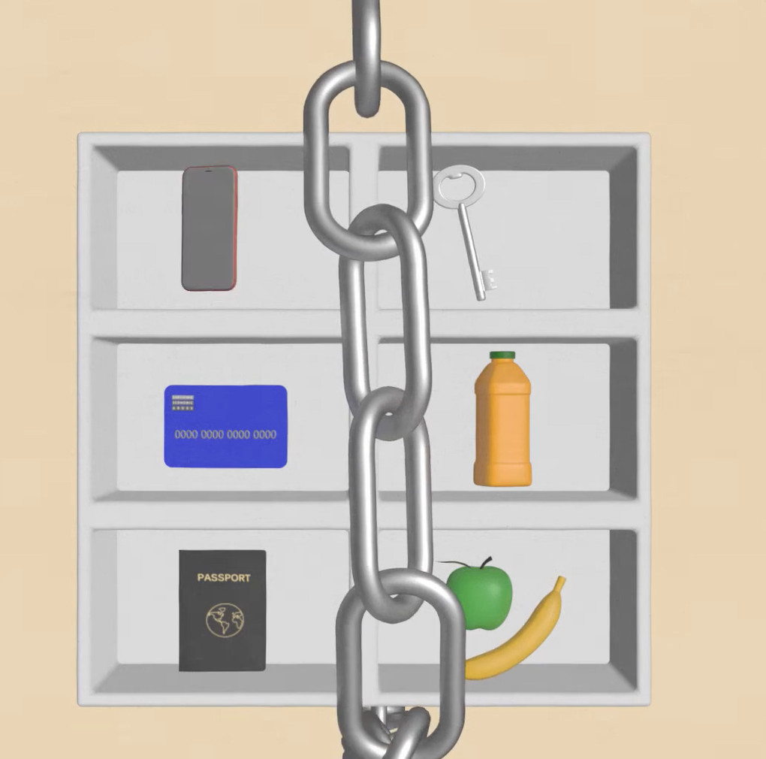
Economic Abuse
What items can you see in the image?
How would you feel if you weren’t able to access them?

Slide 16

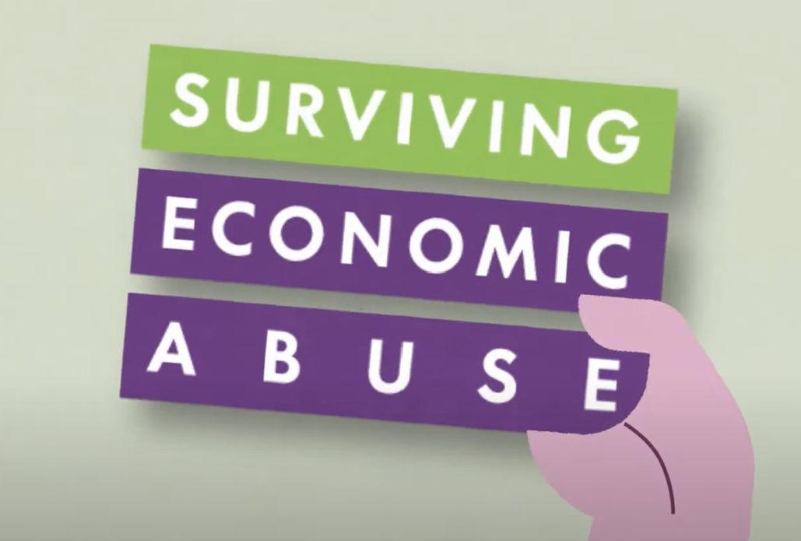
Economic Abuse
Task
Watch the video then complete the definitions below:
Financial abuse | Economic abuse
Economic abuse is often experienced within a pattern of behaviour known as coercive control.
Coercive control is a pattern of t__________, a___________, h____________ and i_________________ or other abuse someone uses to harm, punish or frighten their victim.
Notes:
https://www.youtube.com/watch?v=PLNl9QstDGs

Slide 17
Economic Abuse
Task
Watch the video then complete the definitions below:
Financial abuse | Economic abuse
When the perpetrator steals money, controls income or coerces someone into debt. These behaviours are also found in economic abuse. | When the perpetrator restricts, exploits, or sabotages their partner’s access to money and other resources (food, media, clothing, transport, housing, sleep)
Economic abuse is often experienced within a pattern of behaviour known as coercive control.
Coercive control is a pattern of THREATS, ABUSE, HUMILIATION and INTIMIDATION or other abuse someone uses to harm, punish or frighten their victim.
Notes:
https://www.youtube.com/watch?v=PLNl9QstDGs

Slide 18
Mind-map
What are the impacts of financial and economic abuse on victims?
Task
Mind-map based on the image, video and everything else you have learned today.

Slide 19
Mind-map
Anxiety, depression and lack of confidence
Lack of freedom
Feelings of shame and humiliation
What are the impacts of financial and economic abuse on victims?
Dependence on the perpetrator and difficulty escaping
Basic needs could not be met (food, shelter)
Large sums of debt impacting their financial future
Opportunity cost of not being able to have a career they want
Task
Mind-map based on the image, video and everything else you have learned today.

Slide 20
Myth Busters
1. If it was that bad,
they’d leave.
Click to Reveal
2. You can’t blame someone for their behaviour when they’re drunk or high
Click to Reveal
MYTH!
It can be very difficult to leave an abusive partner. They may be gaslit, isolated, still in love or financially dependent on the abuser
MYTH!
Intoxication can make abuse worse, but they do not cause or excuse abuse. The offender is always responsible for their actions.
MYTH!
Financial abuse has a wide-reaching impact on the victim and society (i.e. their ability to work) and is a criminal offence
3. Financial abuse is a family matter and no one else’s business
Click to Reveal
4. Men cannot be victims of financial abuse
Click to Reveal
MYTH!
Women can also be perpetrators of financial abuse, and men might be less likely to come forward due to societal norms.
MYTH!
Sexual exploitation is a form of financial abuse. They may be coerced into creating sexual content and only receive a small amount of the income
5. Women who feature in porn or on OnlyFans always keep 100% of their wages
Click to Reveal
6. People often lie about being abused
Click to Reveal
MYTH!
According to the Crown Prosecution Service (2022), false allegations about abuse are ‘extremely rare’. This myth is very damaging as it scares and deters women from reporting abuse.
Task
Read the boxes above. In small groups, discuss why you think people might think these things, what the truth is, and why the myth could be damaging.
Notes:
https://www.womensaid.org.uk/information-support/what-is-domestic-abuse/myths/
If it was that bad, they’d leave
Violence isn’t their fault if they are drunk or high
Domestic abuse is a family matter and no one else’s business
Men cannot be victims of domestic abuse
Pornography is not linked to violence against women
Women often lie about abuse

Slide 21




What to do if you recognise abuse
If you are in immediate danger, call 999. If you cannot speak safely, press 55
Have an escape plan if it becomes necessary to leave quickly:
Pack an emergency bag with essentials (clothes, medication, money, phone, documents)
Plan a safe place (or emergency refuge)
Create a code word with someone your trust
Document the abuse
Seek support from a helpline or
report the abuse to the police directly (101)
Notes:
Info from https://ben.org.uk/how-we-help/for-me/articles/what-to-do-if-you-re-being-bullied-online/
Images from FreePik

Slide 22


Domestic Abuse Helplines
Hourglass: Free confidential advice on reporting financial abuse. Call 0808 808 8141
Action Fraud: Report fraud and cybercrimes online
National Domestic Abuse Helpline (England and Wales): Free, confidential advice and support are available 24/7. Call 0808 2000 247 or visit Refuge for online chat services and guidance.
Live Fear Free Helpline (Wales): Call 0808 8010 800 or visit gov.wales/livefearfree.
Men’s Advice Line: For male victims, call 0808 801 0327 or visit mensadviceline.org.uk.
Galop (LGBT+ Helpline): Call 0800 999 5428 or visit galop.org.uk for support tailored to LGBT+ victims of abuse.
Notes:
https://www.independentage.org/get-advice/money/stopping-financial-abuse#:~:text=If%20a%20crime%20has%20been,been%20affected%20by%20a%20crime.

Slide 23
REVIEW YOUR LEARNING OUTCOMES
CONFIDENCE CHECKER
AFTER THE LESSON
Knowledge, Skills & Actions | 1 | 2 | 3 | 4 | 5 | 6 | 7 | 8 | 9 | 10
I can identify types of financial abuse in different scenarios
I can describe the difference between financial and economic abuse.
I can describe at least 5 impacts of financial and economic abuse on victims.
Complete the confidence checker of where you think you are at for this lesson
(Discussion or complete sheet)
3 Minutes
I’m not confident at all on this topic
A little confident
Confident
Very
confident
I am super
confident on this topic
Notes:
TEACHER NOTES & IDEAS
This could be done by writing a number down in the books
Show of fingers in the air or red, amber & green cards
Quick partner discussion
Print off the Assessment Opportunity Sheet – Fill in the Baseline Confidence Checker

Slide 24








Homework
Watch an episode of The Tinder Swindler or Love Con Revenge documentaries on Netflix (or free clips on YouTube).
Make a note of different types of financial abuse and romance scam tactics used.
DUE DATE
It must be submitted by..
Hand / Google Classroom
Notes:
https://commons.wikimedia.org/wiki/File:Netflix-Logo.png
TEACHER NOTES & IDEAS
Ensure students are familiar with the homework task and allow time to answer any questions.
Image -https://www.downs-syndrome.org.uk/about-downs-syndrome/lifes-journey/children-families-and-education/education-project-email-sign-up/

Slide 25



FOR MORE INFORMATION ABOUT THE TOPICS COVERED IN THIS UNIT
WE WOULD ADVISE ONE OF THE BELOW:
SPEAK TO YOUR PARENTS/GUARDIANS, HEAD OF YEAR,
A TRUSTED ADULT OR FRIEND.
IF YOU HAVE ANY CONCERNS ABOUT YOURSELF OR SOMEONE YOU KNOW.
IT IS IMPORTANT TO SPEAK UP AND TELL SOMEONE!
SPECIFIC FURTHER INFORMATION ON THIS TOPIC CAN BE FOUND HERE:
https://refuge.org.uk/i-need-help-now/how-we-can-help-you/national-domestic-abuse-helpline/
Notes:
TEACHER NOTES & IDEAS
Teachers should add in specific local signposting to charities, organisations or local NHS services in their area
Add / adapt or remove any suggested sites.
Print this slide and leave on door notice board after the lesson

Slide 26




Next lesson I would like to...
A question I would like to ask is…
I would like to learn more about…
I know if I need further support or help I could speak to…. or contact…
I now know I can supported others by…
One thing I didn’t realise was… this will help me to…
A problem I overcame today was…
Before I only knew...
now I also know...
The key words for this lesson were…
I’m really proud of the way I have…
Today I have tried to…
The most important thing I have learnt today is…
I used to feel ... but I now feel …
Before I would have done…
Now I will …
2 Minutes
Notes:
TEACHER NOTES & IDEAS
Have students pick either 1-3 tickets depending on their ability and tell a partner
Pick a few students at random to feedback to the class
As students leave the room, have them tell you their reflection on the way out
ATTRIBUTION AND COPYRIGHT
–Icons and logos for Cre8tive Resources are created by Michael Gillman and are subject to copyright ©
- All graphics and images are sourced correctly through the following sites:
Premium licence at https://www.freepik.com/
www.Pixabay.com
https://www.pixelscrapper.com/help
- Factual information is not copyrighted.
- Where information has been taken from reliable 3rd party websites – it is done so for analytical purposes in small pieces of text and for educational purposes.
DISCLAIMER
- Always check the content of any lesson and videos linked before teaching to ensure suitability for your classroom and your school
Responsibility for checking material for suitability for students must be done by the classroom teacher. This includes ensuring everything is appropriate including the external video links that have been provided.
The PowerPoint material is fully editable and we encourage teachers to remove, change or edit anything they wish.
Video links are working at time of creation of this lesson. Please bear in mind YouTube content owners can withdraw their content at any time and responsibility lies with the classroom teacher to ensure the content is updated and new video links are found.
Cre8tive Resources does not charge or provide a subscription update service for this lesson the responsibility for updating lesson content lies with the classroom teacher.
Further Terms and Condition regarding Copyright and our terms of use can be found on our website here https://cre8tiveresources.com/terms-of-use/

