Slide 1


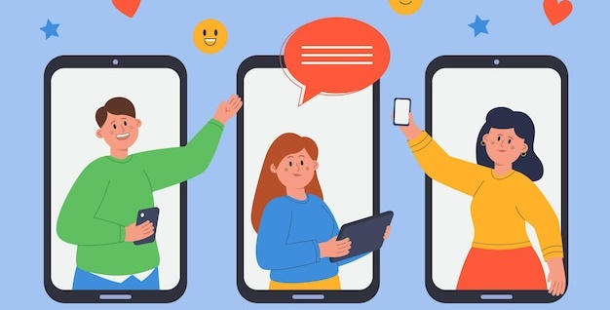




RELATIONSHIPS AND
SEX EDUCATION
Friends, Respect
& Relationships
Monday, 11 May 2026
Friendships & Online Relationships
LEARNING OUTCOMES
Knowledge, Skills
& Actions
To understand the different types of friendships that exist
To understand what an unhealthy relationship might look like
To explore what being a true friend to someone really entails
What does it mean to be a good friend?
What support can an offline friend give you that an online friend can’t?
NEW VOCABULARY
Online Friends, Self-Disclosure, Phubbing, Online Friends, Malicious, Exploited
3 Minutes
Notes:
TEACHER NOTES & IDEAS
Remind students of the learning journey (What theme you are doing – Possibly recap what they can remember from last lesson)
IMPORTANT INFORMATION WITH REGARDS TO RSE
Schools have a legal obligation to be politically impartial. Sections 406 and 407 of the Education Act 1996 state that schools are prohibited from promoting partisan political views, and that where political viewpoints are raised, children ‘are offered a balanced presentation of opposing views.
Further government information aimed at helping schools plan and implement the RSHE curriculum state that schools must comply with the Human Rights Act 1998, which protects the right to freedom of expression..
RSHE guidance re-iterates the importance of parental involvement in a child’s life at school.
ATTRIBUTION AND COPYRIGHT
–Icons and logos for Cre8tive Resources are created by Michael Gillman and are subject to copyright ©
- All graphics and images are sourced correctly through the following sites:
Premium licence at https://www.freepik.com/
www.Pixabay.com
https://www.pixelscrapper.com/help
- Factual information is not copyrighted.
- Where information has been taken from reliable 3rd party websites – it is done so for analytical purposes in small pieces of text and for educational purposes.
DISCLAIMER
- Always check the content of any lesson and videos linked before teaching to ensure suitability for your classroom and your school
Responsibility for checking material for suitability for students must be done by the classroom teacher. This includes ensuring everything is appropriate including the external video links that have been provided.
The PowerPoint material is fully editable and we encourage teachers to remove, change or edit anything they wish.
Video links are working at time of creation of this lesson. Please bear in mind YouTube content owners can withdraw their content at any time and responsibility lies with the classroom teacher to ensure the content is updated and new video links are found.
Cre8tive Resources does not charge or provide a subscription update service for this lesson the responsibility for updating lesson content lies with the classroom teacher.
Further Terms and Condition regarding Copyright and our terms of use can be found on our website here https://cre8tiveresources.com/terms-of-use/

Slide 2

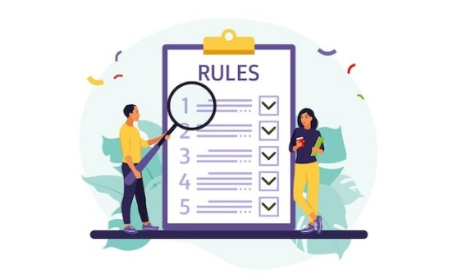


Be Respectful
Listen & don’t interrupt others
Only 1 person talking at a time
Use the agreed appropriate Language (Avoid slang terms)
Be open and honest
No Personal Comments Discussions must be about ‘general situations’
Don’t Make Assumptions about people’s values, attitudes, behaviours, life experiences or feelings
PSHE CLASSROOM RULES
DEALING WITH SENSITIVE TOPICS
SAFEGUARDING YOUR WELFARE & HAVING YOUR INTERESTS AT HEART
You don’t have to say things about yourself if you don’t want to
Be Non-Judgemental No put-downs. Challenge the opinion, not the person
It’s OK to be embarrassed by a topic but don’t show that you are embarrassed through silliness
Conversations on sensitive topics stay in the classroom unless it is a safeguarding issue
There are no stupid questions
It’s OK to get things wrong
Enjoy the lesson, challenge your perceptions and understand how to seek further advice and support
Notes:
TEACHER NOTES & IDEAS
Reinforce ground rules at the start of every new topic / new term
Adapt this set of rules to suit your classroom and your teaching.
Display your agreed PSHE classroom rules in a prominent place so students have a constant reminder and when/if a student breaks a rule you can use as a prompt to get them back on track.
If behaviour is an issue, revisit the ground rules – (Use raffle tickets, positive behavior management (look for the good behaviour)
Reward the behaviour you want to see, be consistent and fair with students.
Create a classroom charter with the students (optional)

Slide 3











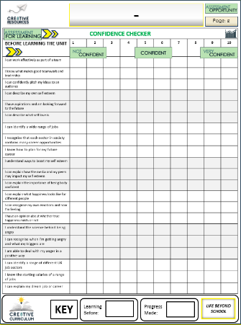


Friendships & Online Relationships
BASELINE CONFIDENCE CHECKER
BEFORE THE LESSON
Knowledge, Skills & Actions | 1 | 2 | 3 | 4 | 5 | 6 | 7 | 8 | 9 | 10
I can recognise if I have unhealthy friendships
I understand the importance of not giving too much information to online friends
I can give good advice to others on what a friendship should and shouldn’t be
Complete a baseline assessment of where you think you are at for this lesson
(Discuss or complete sheet)
2 Minutes
I’m not confident at all on this topic
A little confident
Confident
Very
confident
I am super
confident on this topic
Notes:
TEACHER NOTES & IDEAS
This could be done by writing a number down in the books
Show of fingers in the air or red, amber & green cards
Quick partner discussion
Print off the Assessment Opportunity Sheet – Fill in the Baseline Confidence Checker

Slide 4
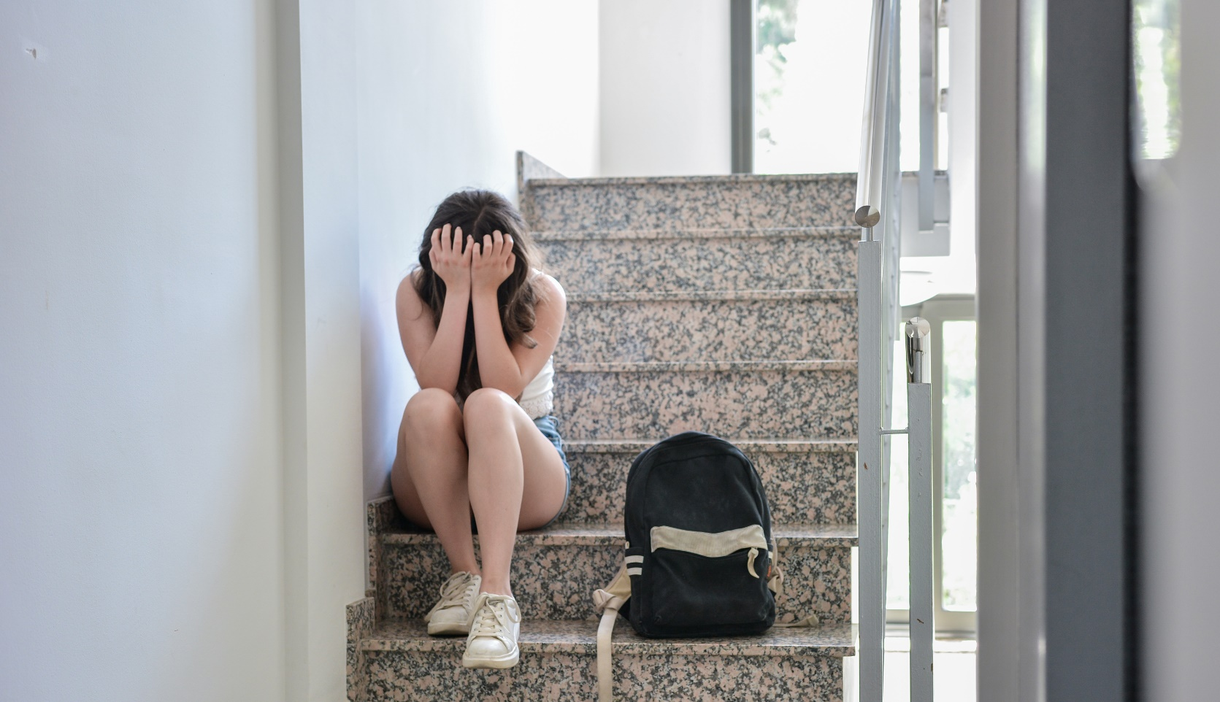


HOW?
WHAT?
WHERE?
WHO?
WHY?
 | DID? | MIGHT? | COULD? | CAN? / WILL? | IS? DOES?
FIRST
SECOND
Use the grid above to help you come up with three questions about the image
2 Minutes
Tasks
Notes:
TEACHER NOTES & IDEAS
Get students to come up with questions using the prompts on the board
Try to get them to think of high level order questions and look past just the image
Extension – Have students try to come up with answers to other students questions
Adapt the image to something you think would be more engaging (We are restricted by Copyright)

Slide 5
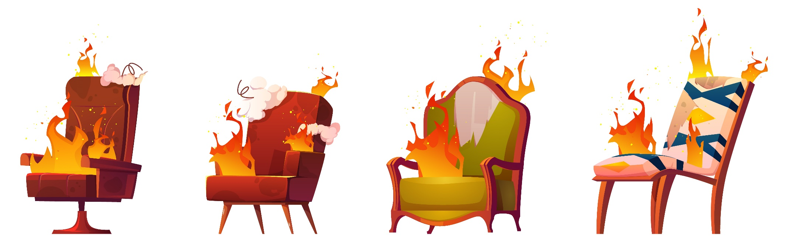
What you should not do in a conversation –
Teacher Check PPT Notes
(CLICK TO REVEAL)
Ask to many questions
Sit far to close
(CLICK TO REVEAL)
(CLICK TO REVEAL)
Act shy
Talk over the top of them
(CLICK TO REVEAL)
(CLICK TO REVEAL)
No eye contact
Act too giddy or overly excited
(CLICK TO REVEAL)
Notes:
TEACHER NOTES & IDEAS
Get a student volunteer to sit next to you and perform a role play – You will chat to them but then do the following:
Ask to many Questions
Act Shy
No Eye Contact
Sit far too close (No personal space)
Talk over the top of them
Act to giddy and hyper
After about a minute pause the role play and allow students to guess the 1 thing you were doing wrong when trying to make a new friend

Slide 6
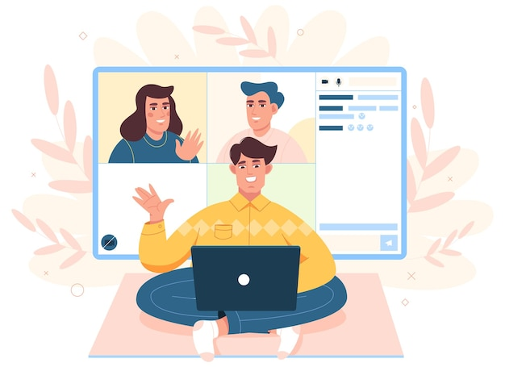
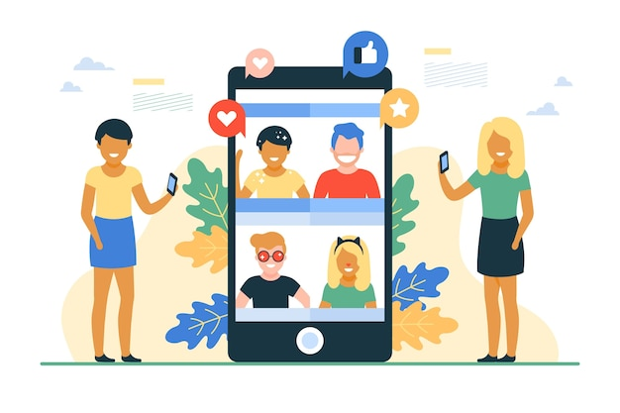
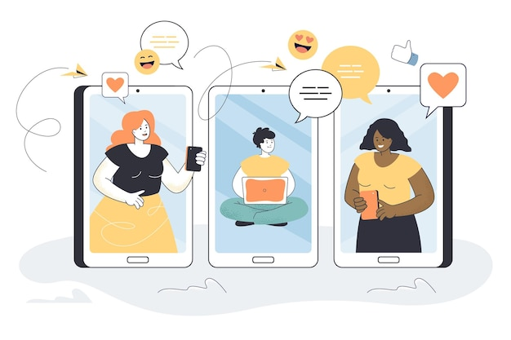
Task
How do you manage all of your friendships?
Which do you prefer?
Chatting to friends online
Hanging out with friends in real life

Slide 7

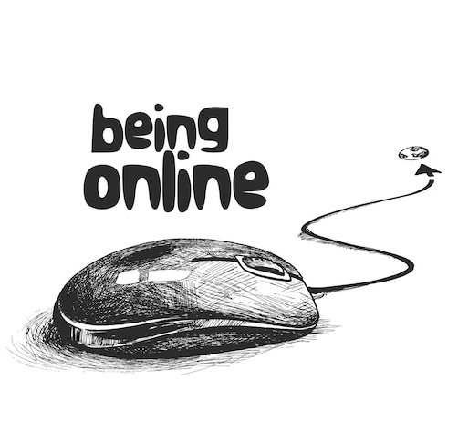
Task
Why do young people place so much value on online relationships?
Can online relationships really make us happy?
Is everyone online who says they are your friend really your friend?

Slide 8

Keyword:
Online Friends: acquaintances, or people you have a friendship with online only through social media
Phubbing: “phone snubbing”, or paying more attention to your phone than to the real people you’re with
Real Life Friends
Online Friends
Know what they look like
Both
May not have met them in real life
Task
Complete the Venn diagram considering the following:
What words do you associate with them?
How well do you know them?
How do you make these kinds of friends?
What do you have in common?
What are the differences between the two?
Is it okay to have more friends online than in real life?

Slide 9

Discussion topics
Why should you never reveal personal information online?
Can you trust someone you only know online?
Is everyone online who they say they are?
How can online conversations be used against someone in real life ?
Why should you not accept every friend request you receive?
Make up a discussion topic
Notes:
TEACHER NOTES & IDEAS

Slide 10




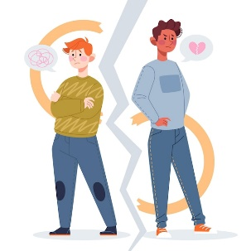

Online Relationships
Demanding access to your online account details for social media platforms and banks
Someone who makes you feel upset
You are being blamed for the other person’s negative or abusive behaviour
Unhealthy online relationship
The person is making you keep the friendship a secret from others
You feel uncomfortable about some of the discussion topics in your chats
You feel they are trying to control parts of your life
You are being sent, or being forced to send sexual images of yourself
You are constantly being checked up on
Notes:
TEACHER NOTES & IDEAS
Information sourced from Childline – Healthy and Unhealthy Relationships

Slide 11


Peg the three most important features of a positive online relationship. Be prepared to justify your answers
Honesty
Clear Boundaries
Did you know?
Trust and Respect
Sharing Secrets
Online relationships can lead to you taking advice from those with malicious intention. You also might find yourself, or a friend, being exploited or abused.
Good Communication
Having a Laugh

Slide 12



Why Keeping Secrets Can Be Harmful
Life Noggin Clip:
Why Keeping a Big Secret Is Worse Than You Think
3 Minutes
INFORMATION
FEELINGS
CREATIVITY
THINKING
JUDGEMENT
Notes:
TEACHER NOTES & IDEAS
If the video is short it may be worth playing it twice – 1st time let students watch carefully and 2nd time have students complete one or two of the hats
Short of time – Play the video and answer a few of the hats afterwards as a class
N.B This is a generic slide and sometimes the hats may not be appropriate for the video clip (if so delete or change accordingly to suit)
N.B Always check the video link is age appropriate to your class before showing student in the lesson.

Slide 13


Tasks
Pick a scenario, and demonstrate your knowledge of the topic by giving Dylan good advice about what he could do.
Some students at school have downloaded a friend’s social media profile picture, made changes, and started sending it to other students at school.
A couple of Dylan’s friends have started to send texts to another pupil which are making the pupil upset. They ask if Dylan can send one from his mobile phone.
Dylan has recently got an Instagram page, and has received some requests from people he doesn't know asking if he can follow them.
Dylan’s best friend tells him that she has been talking to a new friend online via a gaming platform. Dylan doesn't recognise their name and his friend tells him that she is going to meet up with this new friend on Sunday.
Dylan look at a friend’s social media profile and can see where they live, when they were born, their mobile number, and a picture of them in their school uniform

Slide 14

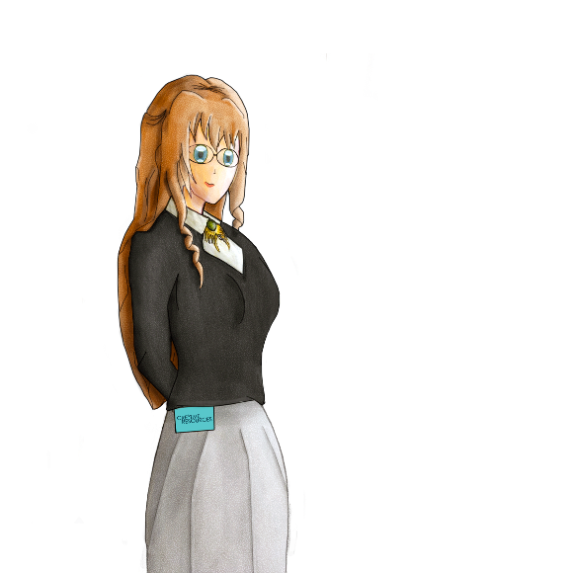




What Do You Think?
“You can never really trust someone who you have only met online”
Talking Points
I think that …
I don’t think… is right because…
My opinion is…
I would argue the same because…
I disagree with… because…
Building on what… said. I think…
An alternate way of looking at this is…
I sort of agree, however….
I would challenge what.. said because ...
?
Do you agree or disagree? Why?
Can you add to the statement?
Do you have a question about the statement?
Would you like to challenge what is being said?
Do you have an alternative idea?
Notes:
TEACHER NOTES & IDEAS
Ask students what they think of this statement
Reveal the talking points after some discussion time
To provoke discussion with a quiet class – play devil's advocate
Challenge a student to a debate

Slide 15

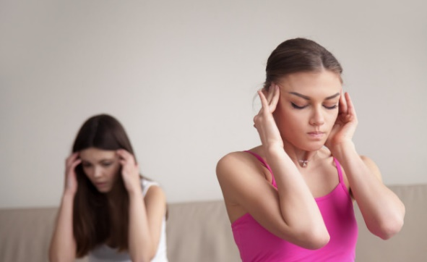
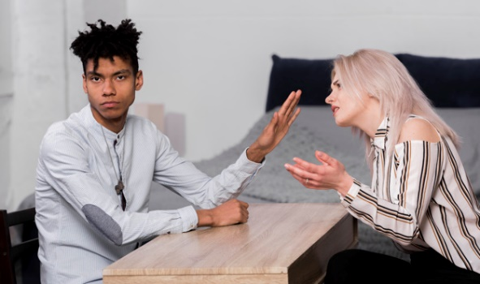
Discuss with a partner
What is your responsibility when you end a friendship with someone?
What happens when you fall out with a best friend?
What could be the cause of conflict in the pictures below?
If someone tells you something that you know they are sensitive about, what should you do?
Can you be friends with someone you can’t trust with a secret?
Did you know?
The psychological term “self-disclosure” is when we share information about ourselves with another person.
Notes:
TEACHER NOTES & IDEAS

Slide 16

FRIENDSHIPS
If I disagree with a friend, I can say so. They can ask why, but ultimately should respect my opinion
A shoulder to cry on, or a helping hand when I feel down
Someone to rely on in a time of crisis
I let a friend know when I feel disappointed by something they have done in a respectful way
Friendships What are they really about?
If my friend is being annoying to me or others, I quietly let them know
I ask for help from my friends when I’m feeling upset
I am able to be who I want to be around my friends
I always try to help my friends If I can
I encourage my friends to pay any money back they owe
Notes:
TEACHER NOTES & IDEAS

Slide 17
REVIEW YOUR LEARNING OUTCOMES
CONFIDENCE CHECKER
AFTER THE LESSON
Knowledge, Skills & Actions | 1 | 2 | 3 | 4 | 5 | 6 | 7 | 8 | 9 | 10
I can recognise if I have unhealthy friendships
I understand the importance of not giving too much information to online friends
I can give good advice to others on what a friendship should and shouldn’t be
Complete the confidence checker of where you think you are at for this lesson
(Discussion or complete sheet)
3 Minutes
I’m not confident at all on this topic
A little confident
Confident
Very
confident
I am super
confident on this topic
Notes:
TEACHER NOTES & IDEAS
This could be done by writing a number down in the books
Show of fingers in the air or red, amber & green cards
Quick partner discussion
Print off the Assessment Opportunity Sheet – Fill in the Baseline Confidence Checker

Slide 18



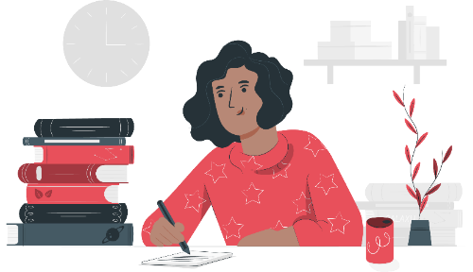




Homework Explained
Create an acrostic poem for FRIENDSHIP
Friendly
Reliable
I
E
N
D
S
H
I
P
DUE DATE
It must be submitted by..
Hand / Google Classroom
Notes:
TEACHER NOTES & IDEAS

Slide 19





2 Minutes
FOR MORE INFORMATION ABOUT THE TOPICS COVERED IN THIS UNIT
WE WOULD ADVISE ONE OF THE BELOW:
SPEAK TO YOUR PARENTS/GUARDIANS, HEAD OF YEAR,
A TRUSTED ADULT OR FRIEND.
IF YOU HAVE ANY CONCERNS ABOUT YOURSELF OR SOMEONE YOU KNOW.
IT IS IMPORTANT TO SPEAK UP AND TELL SOMEONE!
SPECIFIC FURTHER INFORMATION ON THIS TOPIC CAN BE FOUND HERE:
https://www.gottman.com/ - provide a research-based approach to relationships
https://www.childline.org.uk/ - support on all sorts of topics
https://www.youngminds.org.uk/young-person/coping-with-life/friends/ - a guide to friends for young people
https://www.healthline.com/health/benefits-of-friendship
Notes:
TEACHER NOTES & IDEAS
Teachers should add in specific local signposting to charities, organizations or local NHS services in their area
Add / adapt or remove any suggested sites.
Print this slide and leave on door notice board after the lesson

Slide 20



Next lesson I would like to...
A question I would like to ask is…
I would like to learn more about…
I know if I need further support or help I could speak to…. or contact…
I now know I can supported others by…
One thing I didn’t realise was… this will help me to…
A problem I overcame today was…
Before I only knew...
now I also know...
The key words for this lesson were…
I’m really proud of the way I have…
Today I have tried to…
The most important thing I have learnt today is…
I used to feel ... but I now feel …
Before I would have done…
Now I will …
2 Minutes
Notes:
TEACHER NOTES & IDEAS
Have students pick either 1-3 tickets depending on their ability and tell a partner
Pick a few students at random to feedback to the class
As students leave the room, have them tell you their reflection on the way out
ATTRIBUTION AND COPYRIGHT
–Icons and logos for Cre8tive Resources are created by Michael Gillman and are subject to copyright ©
- All graphics and images are sourced correctly through the following sites:
Premium licence at https://www.freepik.com/
www.Pixabay.com
https://www.pixelscrapper.com/help
- Factual information is not copyrighted.
- Where information has been taken from reliable 3rd party websites – it is done so for analytical purposes in small pieces of text and for educational purposes.
DISCLAIMER
- Always check the content of any lesson and videos linked before teaching to ensure suitability for your classroom and your school
Responsibility for checking material for suitability for students must be done by the classroom teacher. This includes ensuring everything is appropriate including the external video links that have been provided.
The PowerPoint material is fully editable and we encourage teachers to remove, change or edit anything they wish.
Video links are working at time of creation of this lesson. Please bear in mind YouTube content owners can withdraw their content at any time and responsibility lies with the classroom teacher to ensure the content is updated and new video links are found.
Cre8tive Resources does not charge or provide a subscription update service for this lesson the responsibility for updating lesson content lies with the classroom teacher.
Further Terms and Condition regarding Copyright and our terms of use can be found on our website here https://cre8tiveresources.com/terms-of-use/

Slide 21





REFER TO MINDFULNESS POWERPOINT
Time for a little something extra?
?? Minutes
Notes:
TEACHER NOTES
Time for something extra?
Pick an activity or reflection question from the mindfulness and wellbeing PPT or add the activity you want on to the end of this PowerPoint before you start the lesson (or use as a starter)

