Slide 1
Uniform Expectations

Slide 2

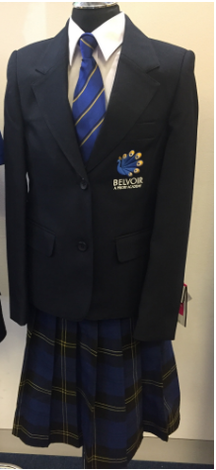

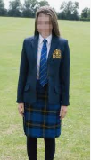
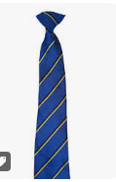
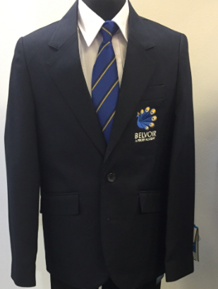
Priory Belvoir Uniform
Belvoir - A Priory Academy - Academy Uniform (belvoiracademy.co.uk)

Slide 3






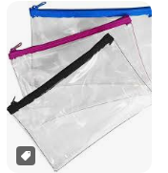
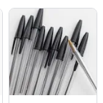

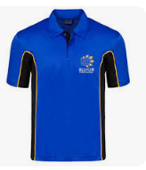
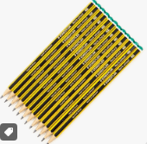
Priory Belvoir Stationery
Essential Equipment
All students must ensure that they have the following equipment with them every day:
School bag
Pencil case
Black or blue writing pens
Pencils
Eraser
Ruler
Colouring pencils
Scientific calculator (Casio fx 83 or 85 'GT plus' is recommended)
Reading book
Glue stick
PE kit
Maths equipment

Slide 4
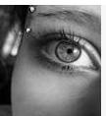
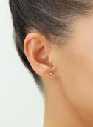
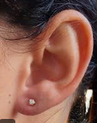

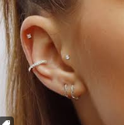
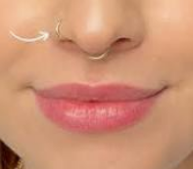
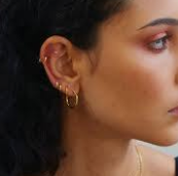
Piercings at Priory Belvoir
ACCEPTABLE :)
NOT ACCEPTABLE :(
1 PLAIN SINGLE STUD PER EAR
RETAINERS ONLY ELSEWHERE

Slide 5

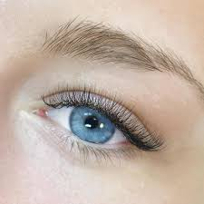
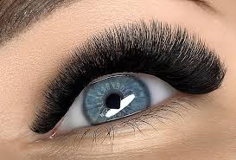
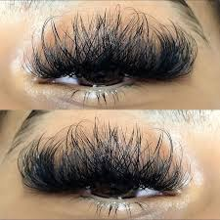
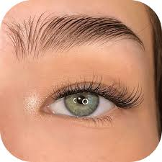
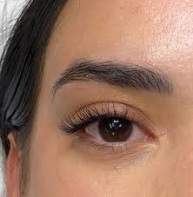
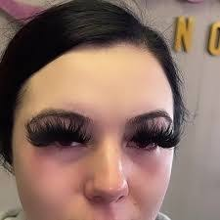
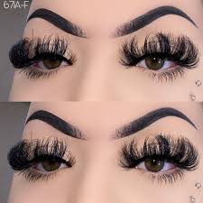
Lashes at Priory Belvoir
ACCEPTABLE :)
NOT ACCEPTABLE :(
NOT ACCEPTABLE :(
ACCEPTABLE :)
MASCARA ONLY
NO FALSE LASHES

Slide 6
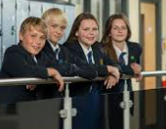
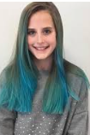

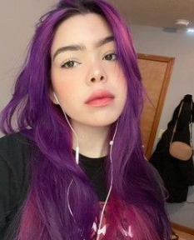
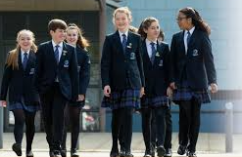
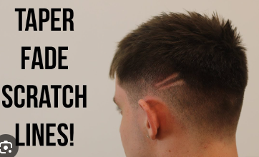
Hair at Priory Belvoir
ACCEPTABLE :)
NOT ACCEPTABLE :(
NOT ACCEPTABLE :(
ACCEPTABLE :)
NATURAL HAIR COLOUR
NO TRAM LINES
NO SKIN SHAVED HEADS

Slide 7
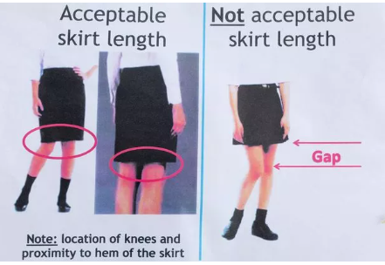

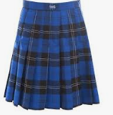
Skirts at Priory Belvoir
ACCEPTABLE :)
NOT ACCEPTABLE :(
NOT ACCEPTABLE :(
ACCEPTABLE :)
NOT ROLLED
KNEE LENGTH
If you have two incidents of rolled skirts in a term, you will then wear trousers

Slide 8
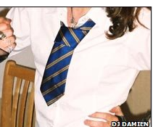
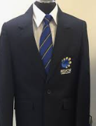
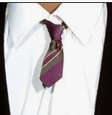
Ties at Priory Belvoir
ACCEPTABLE :)
NOT ACCEPTABLE :(
NOT ACCEPTABLE :(
ACCEPTABLE :)
7 STRIPES –
NO FAT TIES
TOP BUTTONS FASTENED

Slide 9

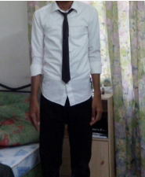
Shirts at Priory Belvoir
ACCEPTABLE :)
NOT ACCEPTABLE :(
NOT ACCEPTABLE :(
ACCEPTABLE :)
SHIRTS TUCKED IN

Slide 10
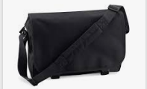

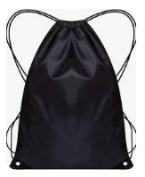
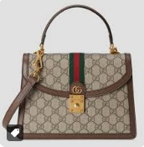
Bags At Priory Belvoir
ACCEPTABLE :)
NOT ACCEPTABLE :(
NOT ACCEPTABLE :(
ACCEPTABLE :)
YOU MUST BRING A BAG
NO BIG BRANDED LABELS
NO HANDBAGS

Slide 11
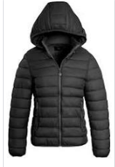
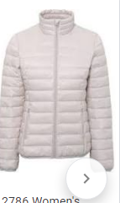
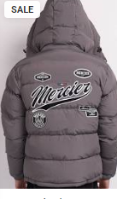
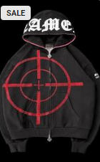
Coats At Priory Belvoir
ACCEPTABLE :)
NOT ACCEPTABLE :(
NOT ACCEPTABLE :(
ACCEPTABLE :)
NO BIG BRANDED LABELS
NO HOODIES

Slide 12
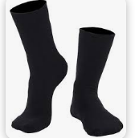
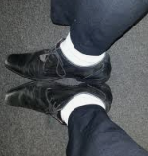
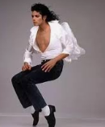
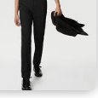
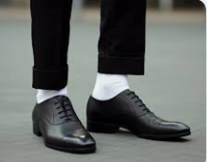
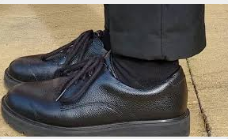
Socks at Priory Belvoir
ACCEPTABLE :)
NOT ACCEPTABLE :(
NOT ACCEPTABLE :(
ACCEPTABLE :)

Slide 13
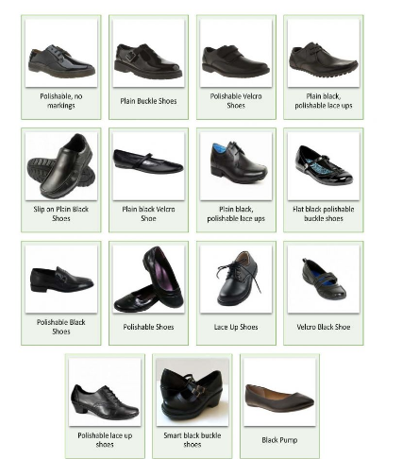
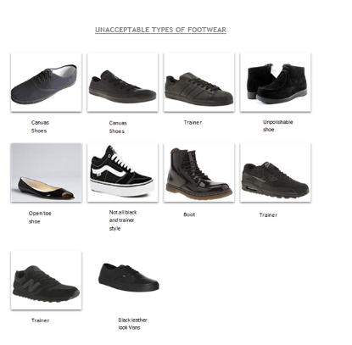
Shoes at Priory Belvoir
ACCEPTABLE :)
NOT ACCEPTABLE :(
NOT ACCEPTABLE :(
ACCEPTABLE :)

Slide 14
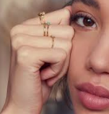
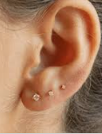
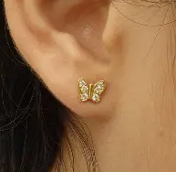






Jewellery at Priory Belvoir
NOT ACCEPTABLE :(
ACCEPTABLE :)
NOT ACCEPTABLE :(
ACCEPTABLE :)
NO RINGS
NO BRACELETS
NO NECKLACES
Round single stud earrings only

Slide 15










PE Kit at Priory Belvoir
ACCEPTABLE :)
NOT ACCEPTABLE :(
ACCEPTABLE :)
NOT ACCEPTABLE :(
Hot pant shorts
Crop tops
Ear rings
Hair down
Coats

Slide 16






Belts at Priory Belvoir
ACCEPTABLE :)
NOT ACCEPTABLE :(
NOT ACCEPTABLE :(
ACCEPTABLE :)
PLAIN BLACK BELT
NO BUMS EXPOSED
NO SAGGING!

Slide 17




Trousers at Priory Belvoir
ACCEPTABLE :)
NOT ACCEPTABLE :(
NOT ACCEPTABLE :(
ACCEPTABLE :)
No leggings
lain black (straight, classic style – no stretch fabrics, turn ups or flairs).
Trousers should not be cropped
NO SAGGING!

Slide 18
Thank you

